Slide 1

ACADEMIC WRITING AND SCHOLARSHIP SSGC8807
2. The Anatomy of a Research Article
Richard Fitzgerald

Slide 2

Recap
What this course is about
What this course is not about
Attitude to the course (Seminar)
Attendance (Professional)

Slide 3
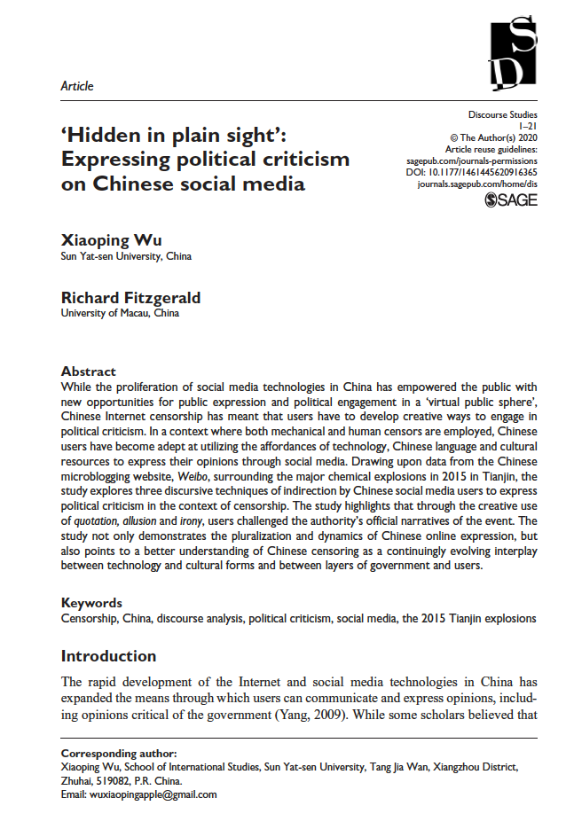

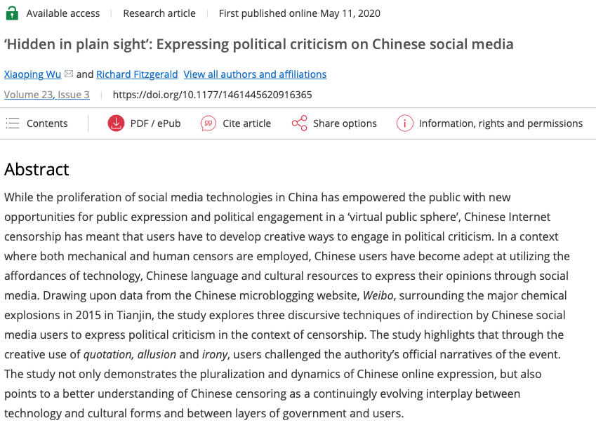
The Anatomy of This Research Article

Slide 4

Structure of (The) Research Article
Title
Abstract
Introduction
Data and Method
Analysis
1. Quotations
2. Allusion
3. Irony
Summary/Discussion

Slide 5
A series of Inverted Pyramids, except the final one.
Structure of a Research Article and the Power of 3
Introduction – Phenomenon/Issue
Literature Review on Phenomenon. Research contribution
Data and Methods + Contribution
Analysis 1, 2, 3
Summary/Conclusion – So what?

Slide 6
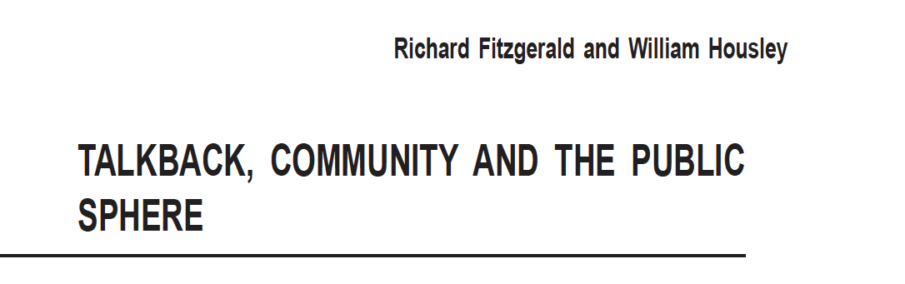
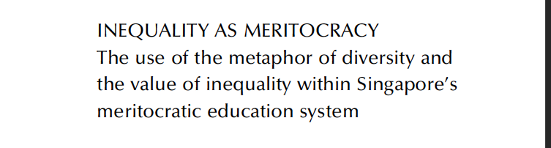

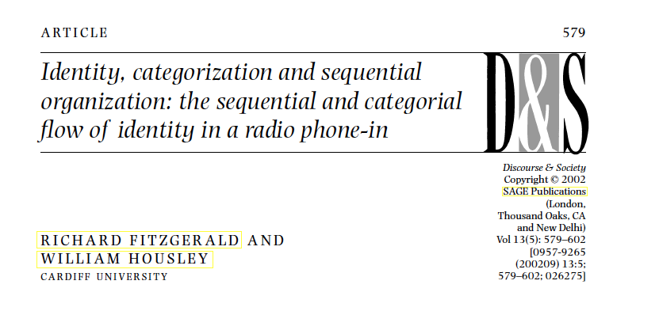
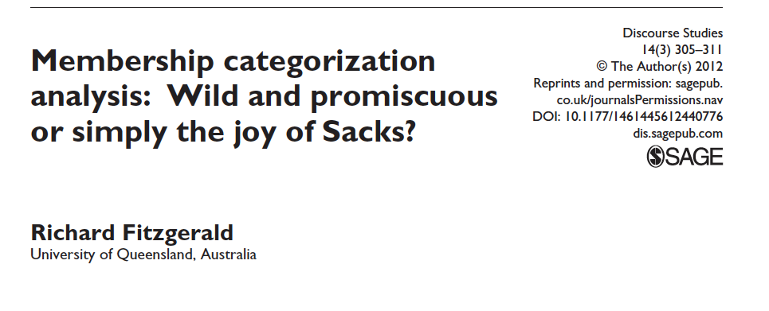
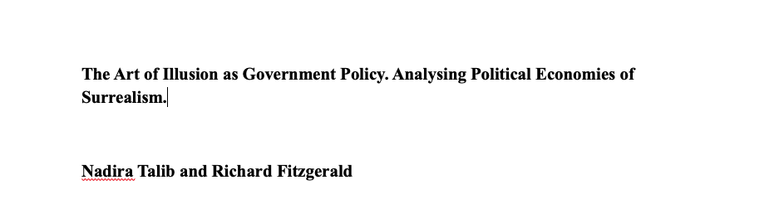
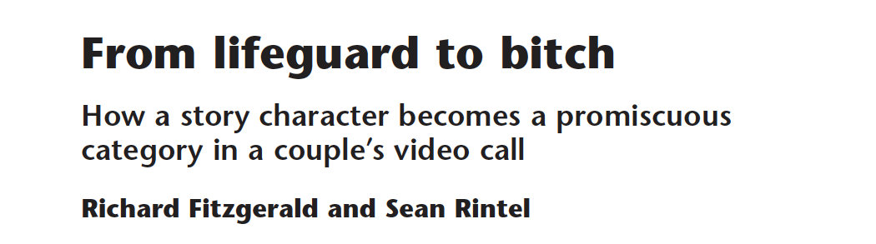
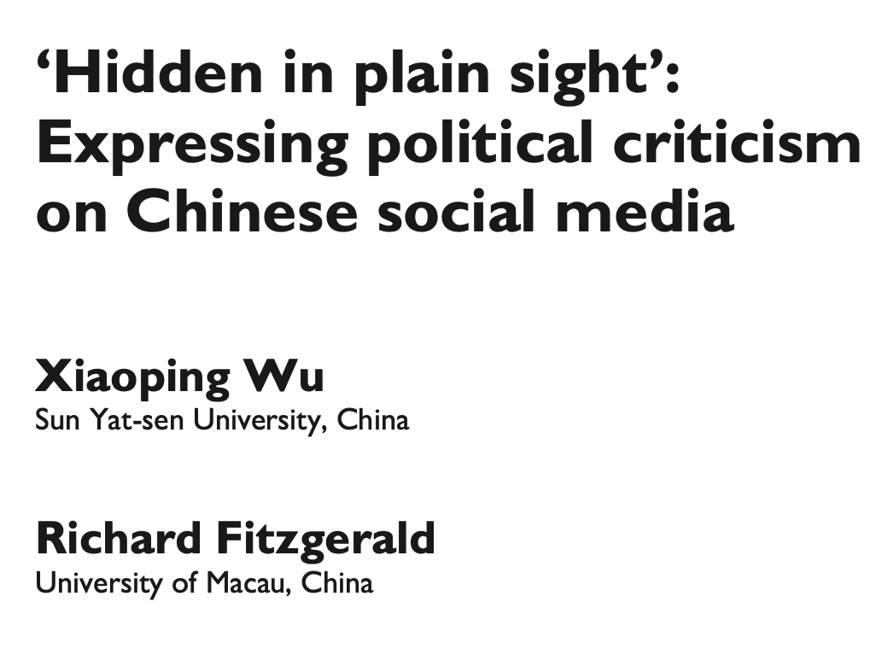






Title. Short and Long. Designed to grab the attention
Reaching for the stars: DingTalk and the Multi-platform creativity of a ‘one-star’ campaign.
Xiaoping Wu & Richard Fitzgerald

Slide 7
“Nonetheless, although these guides are invaluable, the real “joy of Sacks”, as Fitzgerald (2012) memorably puts it, lies in reading and engaging with his work for ourselves, as anyone who has begun to delve into the Lectures on Conversation, his transcribed lectures, quickly comes to see” Mair and Sharrock (2021) Action, meaning and understanding. Seeing sociologically with Harvey Sacks.

Slide 8
Abstract. The sell.
Abstract
While the proliferation of social media technologies in China has empowered the public with new opportunities for public expression and political engagement in a ‘virtual public sphere’, Chinese Internet censorship has meant that users have to develop creative ways to engage in political criticism. In a context where both mechanical and human censors are employed, Chinese users have become adept at utilizing the affordances of technology, Chinese language and cultural resources to express their opinions through social media. Drawing upon data from the Chinese microblogging website, Weibo, surrounding the major chemical explosions in 2015 in Tianjin, the study explores three discursive techniques of indirection by Chinese social media users to express political criticism in the context of censorship. The study highlights that through the creative use of quotation, allusion and irony, users challenged the authority’s official narratives of the event. The study not only demonstrates the pluralization and dynamics of Chinese online expression, but also points to a better understanding of Chinese censoring as a continuingly evolving interplay between technology and cultural forms and between layers of government and users.
Keywords
Censorship, China, discourse analysis, political criticism, social media, the 2015 Tianjin explosions

Slide 9
Abstract – The anatomy
Main Context. Everyone knows this.
While the proliferation of social media technologies in China has empowered the public with new opportunities for public expression and political engagement in a ‘virtual public sphere’, Chinese Internet censorship has meant that users have to develop creative ways to engage in political criticism.
The event of interest
In a context where both mechanical and human censors are employed, Chinese users have become adept at utilizing the affordances of technology, Chinese language and cultural resources to express their opinions through social media.
Focus of the paper – Method and data
Drawing upon data from the Chinese microblogging website, Weibo, surrounding the major chemical explosions in 2015 in Tianjin, the study explores three discursive techniques of indirection by Chinese social media users to express political criticism in the context of censorship.
The actions focused on
The study highlights that through the creative use of quotation, allusion and irony, users challenged the authority’s official narratives of the event.
Outcome
The study not only demonstrates the pluralization and dynamics of Chinese online expression, but also points to a better understanding of Chinese censoring as a continuingly evolving interplay between technology and cultural forms and between layers of government and users.
KEYWORDS Censorship, China, discourse analysis, political criticism, social media, the 2015 Tianjin explosions (search words)

Slide 10
The “Introduction”
1
Gives the context of the event and the paper.
Why would this be interesting to the academic reader?
The rapid development of the Internet and social media technologies in China has expanded the means through which users can communicate and express opinions, including opinions critical of the government (Yang, 2009). While some scholars believed that such development would transform the Chinese Internet into a relatively free and vibrant discursive space and virtual public sphere that facilitated critical discussion of social and political issues, formation of public opinions, and occasional collective mobilizations (Han, 2015; Lagerkvist, 2010; Montgomery et al., 2015; Su, 2016; Yang, 2003, 2009), this has increasingly shown to be more complicated as Chinese censorship has become increasingly effective (Ju et al., 2019; MacKinnon, 2011; Sullivan, 2014). Within this context, Weibo, a microblogging service that was launched in 2009 and originally based on Twitter has continued to provide a distinct socio-political function and become one of the most powerful channels for the articulation of critical attitudes of socio-political issues. Along with WeChat and other popular social media apps that were originally based on existing apps like Twitter, Facebook, YouTube, and so on, Weibo has developed beyond the affordances of Twitter and now offers a range of technological features on top of the original design (Rauchfleisch and Schäfer, 2015; Wu, 2018).
What do we want to convey – what is the hook?
Censorship, its complicated.
The apps in the west are different from those in China
Technological affordances are different
Use is shaped by context and resources and is different.
The Phenomenon

Slide 11

The “Literature Review”
2
Censorship and counter-censorship – Previous research on censorship and what they got wrong
Censorship in China has been a recurring theme in Western coverage of the country and regarded as an increasing practice of Chinese government information control (Yang, 2016). Internet censorship constitutes an indispensable part of the Chinese media land- scape where censoring through surveillance mechanisms blocks foreign websites like Twitter, Facebook and Google, and monitors, filters and deletes content that is deemed politically sensitive. Chinese Internet censorship practices are done both through software technologies and human power. Software technologies mainly refer to blocking certain websites and keyword filtering which stops users from posting verbal texts that contain banned words or expressions. However, human power censoring refers to parties acting putatively ‘on the government’s behalf’ at the central, provincial and local governmental levels including Internet police who physically examine and delete online content.
Rethinking the dichotomy of ‘control and resistance’ Where people get it right and where we contribute
Besides highlighting the creative ways users attempt to circumvent censorship, these studies also show that forms of resistance and control do not stand still but evolve in tandem with users’ creativity in design along with new censorship technologies and political initiatives. At the heart of these studies is the creativity of the users in terms of technology, culture and language to create a multimodal form of communication where the expression of something seemingly benign hides the act of political criticism. Building upon this previous research, the analysis below examines further the discursive forms that Chinese social media users draw upon through technology and shared linguistic and cultural resources to express political criticism during a major disaster as it unfolds and local government attempts to censor critical social media.
All the possible literature
A
B
Where we want the reader to end up

Slide 12
The “Data and Method”
3
The Event
On the midnight of 12 August 2015, a series of massive blasts took place in the chemical storage warehouses located in Tianjin (a major port city close to Beijing). The blasts, according to Chinese official reports, killed 173 people and injured nearly 800, and caused heavy economic loss and unknown environmental effects. This accident is documented as one of the most serious industrial accidents since the founding of the PRC in 1949.
Data collection
The data for the study are 1322 posts containing the keyword ‘Tianjin Explosions’ collected from Weibo between 23:00 on 12 August (when the accident occurred) and 24:00 on 20 August 2015 (when the situation was under control). This dataset first cap- tures Weibo users’ general reaction to the Tianjin accident and a picture of the digital scene a week later. The selected examples have been translated into English for this study and due to ethical concerns, pixilation is used to blur out the names and features of the authors of the selected examples.
Description of the data and event
….Meanwhile, slow reactions from the Tianjin government and local mainstream media meant that the official response was largely absent in the immediate aftermath of the explosions. This ‘liminal zone’ (Fitzgerald and Evans, 2018) was filled with speculations regarding the casualties, the truth behind the tragedy, and criticism of the local government and official media that went viral before targeted forms of censorship were imposed by the authorities.
Actual data
Against this backdrop, users creatively drew upon technological and cultural affordances to keep their comments digitally alive. In terms of technical tactics, users took advantage of the immediacy and ephemeral nature of social media by posting and sharing one step ahead of the censorship, creating different hashtags such as ‘Tianjin explosions’ to replace the old one, as well as converted verbal texts into pictures (such as screenshots of microblogs posted by other users) that can be embedded in a microblog without being detected by the censors. Along with these technological means and affordances, Chinese culture and language have provided resources for social media users to express political criticism through seemingly benign posts as well as posts which ostensibly support the government….

Slide 13
The “Analysis” – applying the rule of 3s
We have identified three interesting methods that Weibo users adopted to express political criticism. These three methods share one thing in common: indirection that involves implied meaning and the creative use of language.
Why 3?
Structure of an Argument
1 - an example
2 – a collection
3 – a pattern
Depth of analysis -
1. Quotations
2. Allusion
3. Irony
The “Rule of Three,” a renowned writing principle, suggests that when things come in threes, they are inherently funnier, more satisfying, or more effective than other numbers of things. Think of a famous phrase or slogan and chances are it's structured in three.
Analysis 1, 2, 3

Slide 14

The Analysis Sections are not just a list. Each Analysis Section Builds on the Previous Analysis Section
Quotations -
Begin with the clear examples of the interesting phenomenon (Example)
The Reader can see this easily.
The Reader is attuned to what kind of thing you are looking at
Allusions –
Adds more complexity, establishes phenomena (Collection)
Next layer of analysis –
Something the Reader may not have seen immediately.
Irony –
Adds more complexity, something the reader would not have seen, known. (Argument/projection)
Completes the argument (rule of 3s)
Complicates the argument (something that is not noticeable)

Slide 15
The “Summary/Discussion”. The ‘so what’?
1. What have you done and what does it mean?
2. What did it show?
In the case of the Tianjin explosions, the creativity is shown through the resources drawn upon in the in-situ design of political criticism to be understood by those who it is designed for, but also hidden within in the overall context of Chinese online censorship. Through these resources, users are able to hide criticism among the discursive foliage for the reader to find. This is not to suggest, however, that the parties act in isolation from each other. After all, the human censors and social media users are Chinese citizens with similar language, cultural background and technological access. Rather, there is a cat and mouse relationship with each drawing on various resources within a constantly evolving censorship environment. In this multi- layered environment, users not only act and react upon their knowledge of each other, but are also intertwined with each other, as each new form of resistance and control stimulates both sides to further develop techniques to counter and compete with each other.
Summary/Conclusion – So what?

Slide 16
The “So What?” Why are you telling me this? How does this contribute to what we already know? Connect back to the literature – how does this add to the particular research on this topic. 1. Online Censorship should be understood as multilayered.

Slide 17
So what 1?. Online Censorship should be understood as multilayered.
Understanding Chinese censorship beyond the one dimensional
However, it is important to understand the context of Chinese censorship as layered between the public as well as different levels of government with their own agendas.
On the one hand, political criticism about the event took place at the level of the Chinese public and local governmental sectors, reflecting a lack of trust in official statements and calling for those responsible to be held accountable.
On the other hand, the local government is subject to a further layer of power of the central government, such that the local government was sandwiched between the public and the central government.
During the first 2 weeks after the explosions, the central government monitored the situation and intervened when it was necessary (e.g. designating a group of state officials to assist the relief work and investigation, as well as censoring and clarifying ‘rumors’ on social media). Thus, despite the ability to shut down criticism of the local government and even suspend the platform, the state government used this criticism to advance its own policy of anti-corruption by allowing Weibo users to highlight possible corruption at a local level.
This also meant the local government was left alone to deal with the public anger and deflect scrutiny from the central government. This adds weight to the argument that online political criticism can be useful to the state when used selectively because it allows a safe degree of criticism of local and regional levels of government and meanwhile, does not assail the Party’s political leadership in China (King et al., 2013; Shao, 2018).

Slide 18
So What? 2. The Creativity of the Game of Cat and Mouse
Understanding censorship as both layered and as somehow collaborative as they push each other.
It would then be mistaken to think of these human censors as somehow not aware of the techniques, or lacking the same pragmatic knowledge used by other social media users to circumvent or avoid censorship.
That is, censors and monitors should be seen as possessing the same kind of pragmatic competence and shared scheme of interpretation as social media users do, which means that they will be able to identify the political criticism hidden in plain sight once it is there.
Therefore, it is fair to say that the proliferation and advances of the Internet and social media technologies not only empower Chinese users with new opportunities to counter the might of the authorities, but they also empower the censors with more sophisticated means to control the public discourse (Albeanu, 2017).
In this game of cat and mouse, both Chinese users and censors act and react based on their mutual understanding. Such mutual understanding keeps growing as the Internet censorship apparatus is evolving and the Chinese users are developing new tactics to cope with it.

Slide 19
The “Limitations” and “Future Research” Sections
I am not a particular fan of sections on ‘future research’. Its like saying yeh look at my awsome research which you can carry on for me. Why would you assume that others would value your research that much to take on your research and why not do the future research yourself? Let them decide…… You will see it in the future citations
I prefer ‘seeding’. Introducing concepts and ideas into the research, to clear the ground and plant the seed for further studies.
Chinese Social Media is different from Western Social Media – technology, affordances, and use. It is itelf an area of study
Chinese Social Media is characterised by forms of creativity – its context is different from outside China and it is put to different uses.
(The creativity is both in the affordances of individual platforms but also within a cross platform environment. Chinese social media platforms do not exist in silos.)
So how was it received?

Slide 20
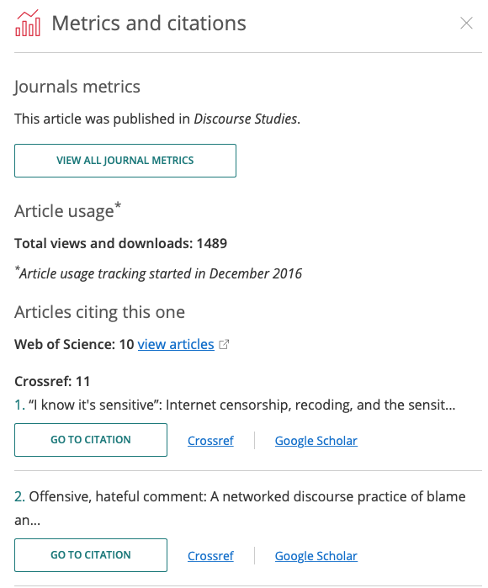
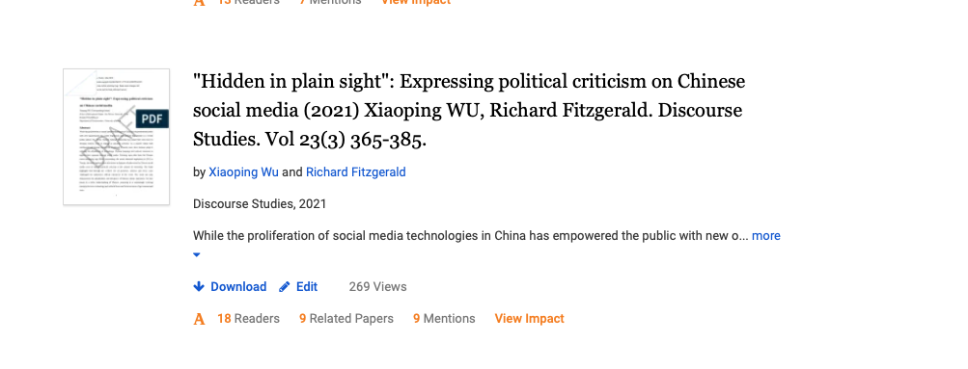
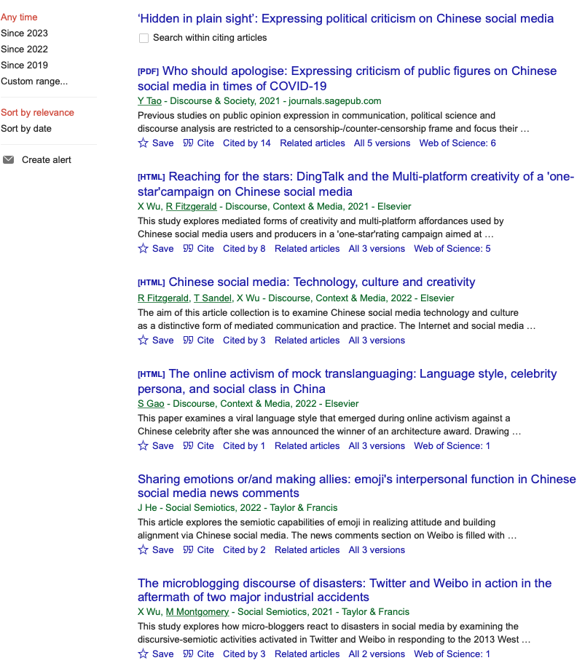
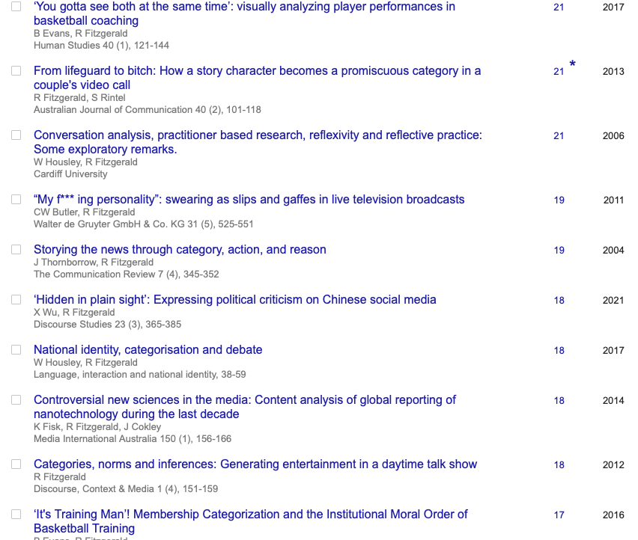

Slide 21


Slide 22
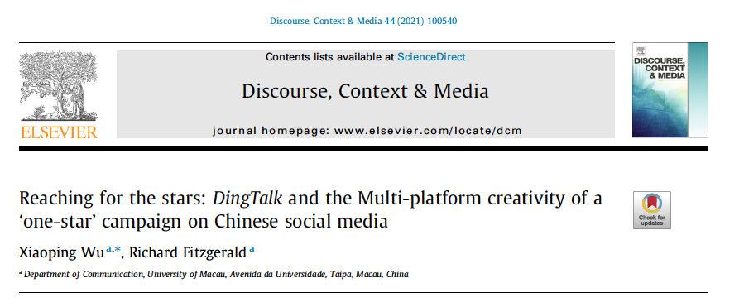
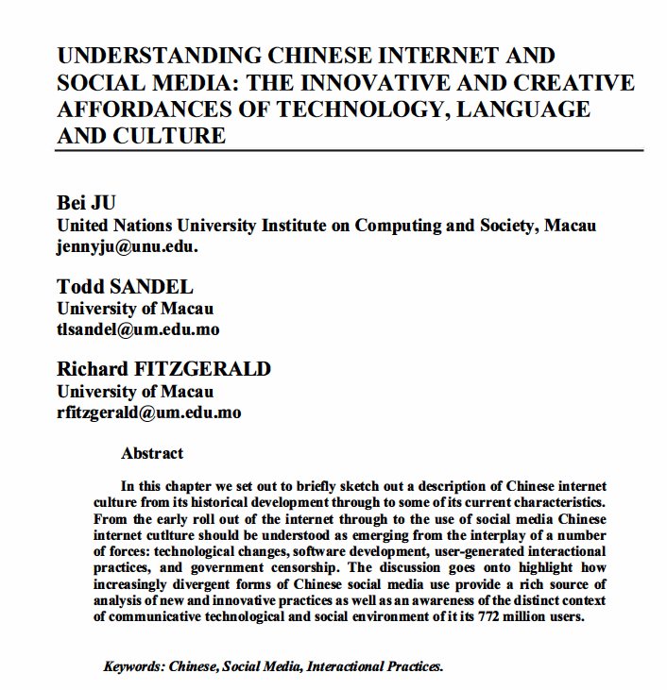
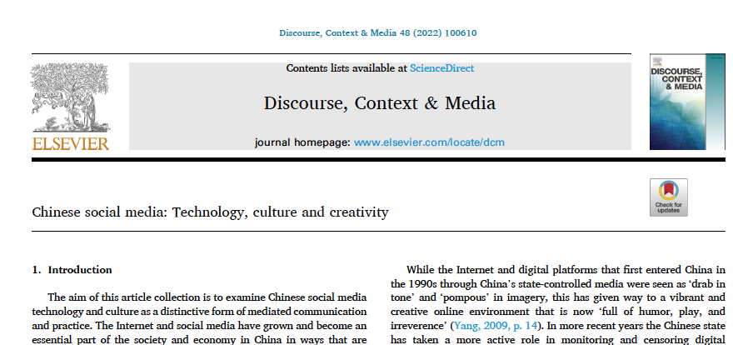
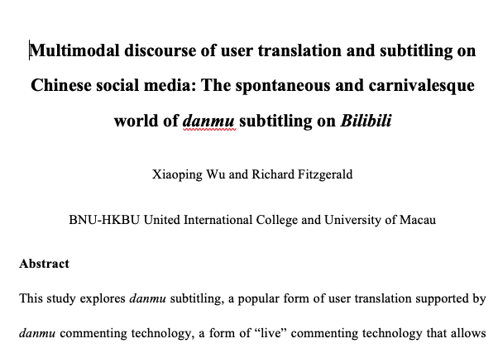
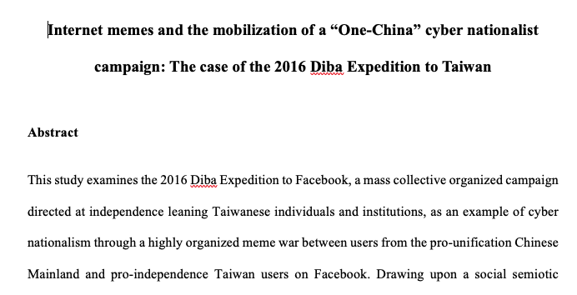
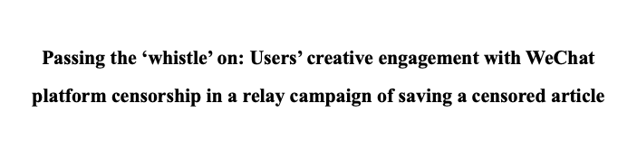
Establishing the context for next studies. There is more than WeChat and Weibo. Multiple Apps, Cross Platforms, The Carnivalesque Environment

Slide 23
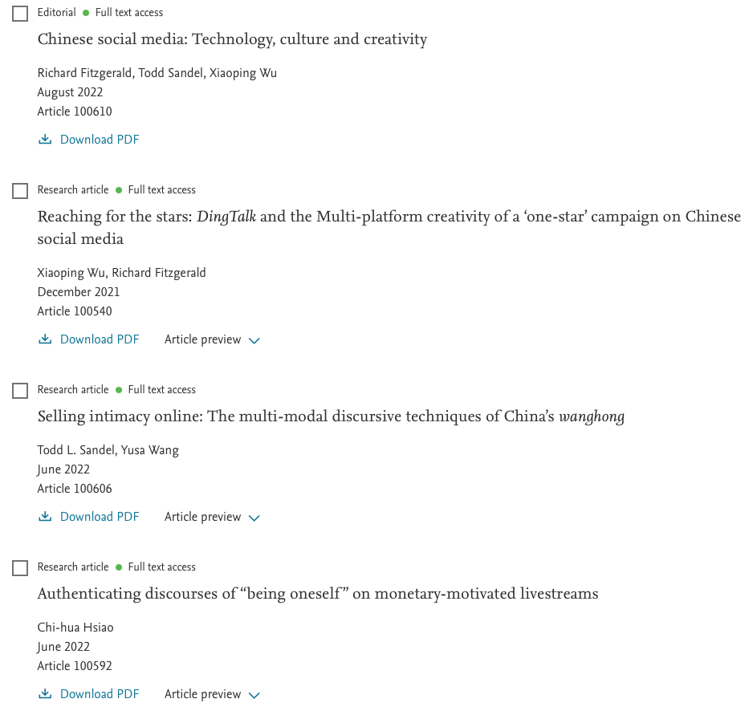
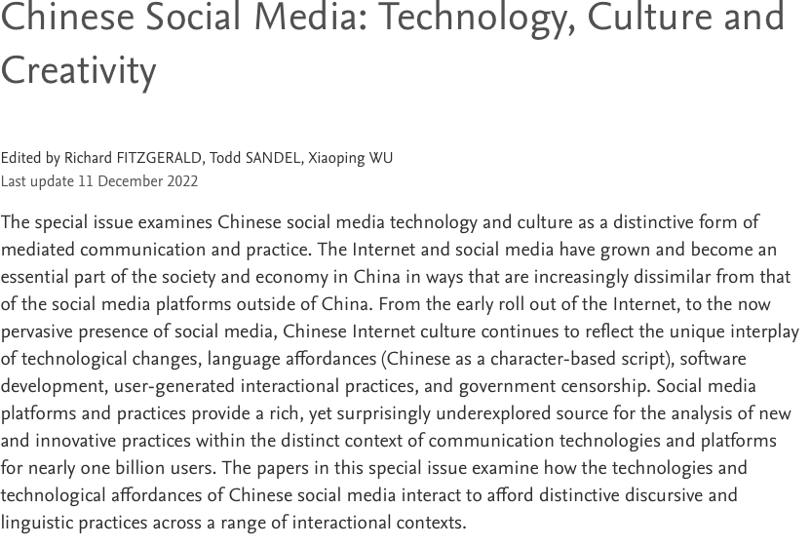
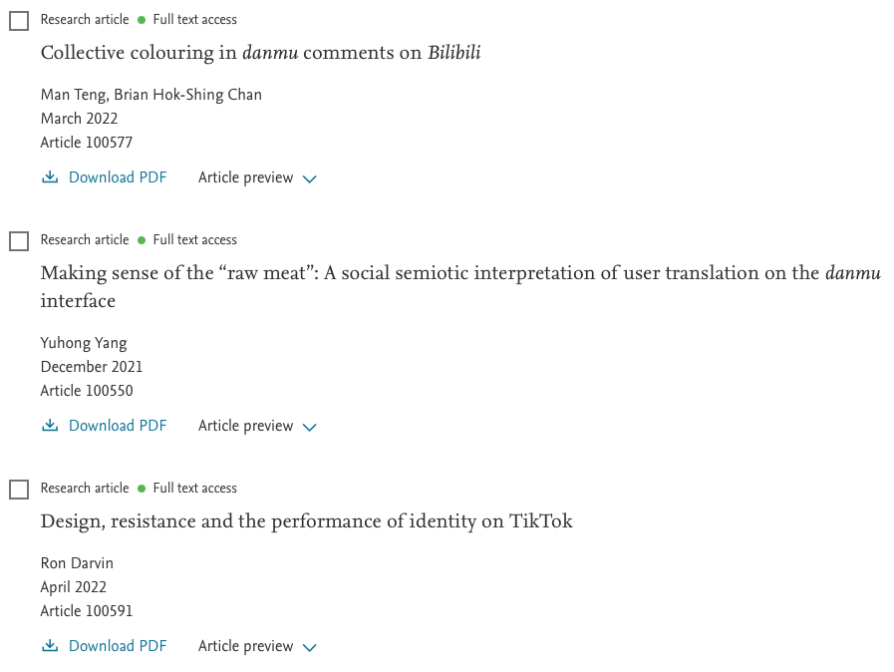
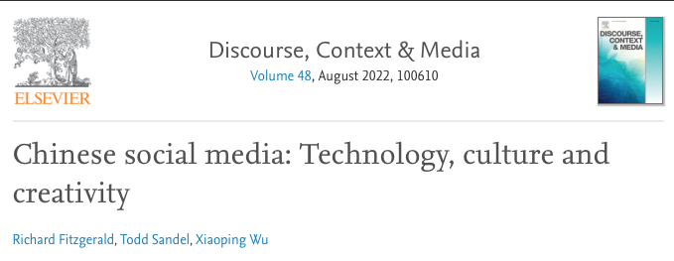
Journal Special Issue

Slide 24
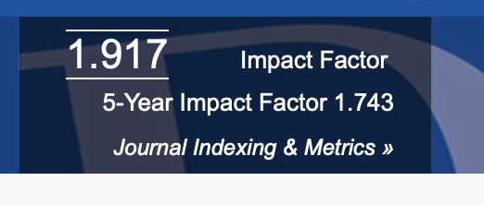
Finally - Why Choose Discourse Studies? Choosing a Journal How to ‘read’ a journal, who are the intended audience?
Who would be interested in this?
Aims and Scope of the journal
Quality of the Journal (Impact Factor, SSCI ranking)
Publishes similar papers – form of analysis and focus of analysis.
Peer Reviewed.
Core Discourse Analysis Journals
Discourse Studies
Discourse and Society
Discourse and Communication
Discourse, Context and Media
Social Semiotics
Talk and Text
Critical Discourse Studies
Journal of Pragmatics
Pragmatics
New Media and Society
88 % of submissions are ‘desk rejected’

Slide 25

Why do you want to Publish? What/who are you publishing for? Universities do not usually care what you publish as long as you publish – universities or even your colleagues are not usually aware of your research area or topic. Your research audience is often not in your University

Slide 26
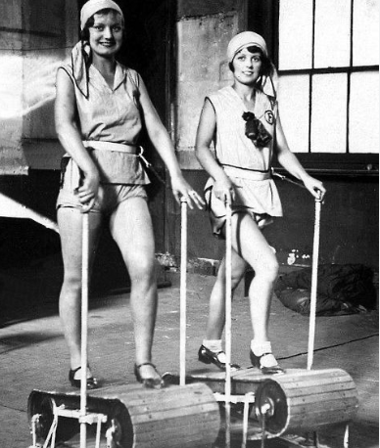
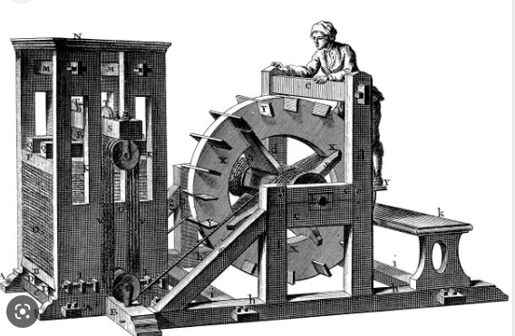
The Publishing Game. Different Universities Play by Different Rules.
For you -
Because you have something to say about a topic that no one seems to have said yet.
Because you want to help shape the field.
Because you enjoy writing – the process
Because you want to join in/ contribute to the conversation
For the University -
Because you have to.
Publications (not research) are treated as a/the tangible measure for your salary.
Numbers of Papers (the treadmill)
Metrics of Publications (citations)

Slide 27
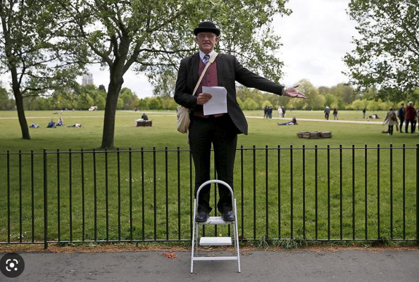

How do you know you are part of the Conversation.
Did it happen? Is it Published?
Is anyone listening? Is it cited?
Assignment 1 – Contributing to the Conversation.

Slide 28

